Slide 1

The Roller-Coaster Problem: A Multithreading application
Team Members
Sateesh - 19071A0505
Roshan Kumar - 19071A0509
Yaswanth Reddy - 19071A0514
Hruday Vikas - 19071A0526
Shankar -19071A0527
Vinay - 19071A0553
III CSE - A | OS LAB | Course Based Project Review

Slide 2
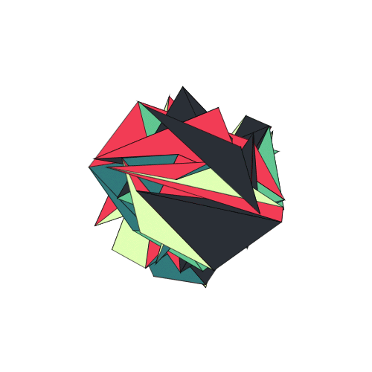
Abstract
In computer science, the Roller-Coaster problem is an example problem of synchronization, often used in concurrent algorithm design to illustrate synchronization issues and techniques for resolving them.
This project involves designing an algorithm and implementing it to illustrate how the Roller-Coaster problem is resolved, using the Operating System as the external supervisor, and by making use of the semaphores.

Slide 3
Introduction
Multithreading is a phenomenon that allows two or more instruction threads to execute independently while sharing the same process resources.
However, multithreading comes with synchronization issues, such as memory inconsistencies and thread interference issues (race conditions).
Semaphores and monitors are the tools at the disposal of an Operating System, to take care of these synchronization issues.
To demonstrate how these issues of synchronization are resolved, we make use of some example problems of synchronization, and one such problem is the Roller-coaster problem.
Notes:
Race Condition: When multiple threads try to read and write a shared variable concurrently, and these read and write operations overlap in execution, then the final outcome depends on the order in which the reads and writes take place, which is unpredictable. This phenomenon is called Race condition.

Slide 4
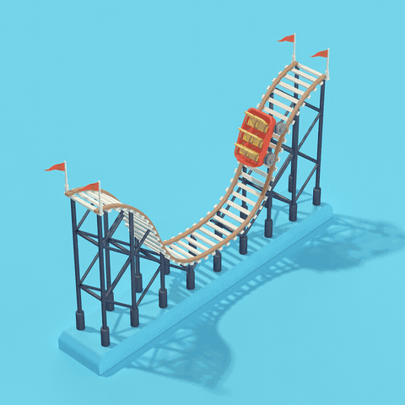
The Roller-Coaster Problem
What is the Roller-Coaster problem?
The Challenge

Slide 5

What is the Roller-Coaster problem?
It is assumed that there are n passengers and one roller coaster car.
The passengers wait to ride in the car, which can hold a maximum of C passengers, where C < n.
However, the cheapskate owners won't let the car leave the station until it is full.
In simpler words, each passenger waits to take a ride, gets on the ride, then waits until the ride completes, disembarks from the ride and exits.

Slide 6
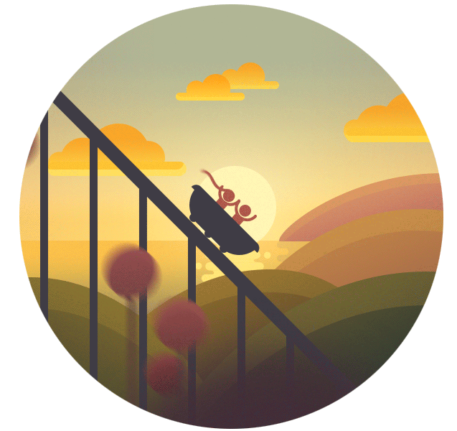
The Challenge
The challenge is to develop a program that can simulate this system, while fulfilling the following requirements:
The car and each passenger are represented by separate threads.
The car always rides with exactly C passengers.
No passengers will jump off the car while the car is running.
No passengers will jump onto the car while the car is running.

Slide 7
Hardware Requirements
A hardware requirements list is often accompanied by a hardware compatibility list, especially in case of operating systems.
​RAM: Minimum of 1GB; 4GB and higher recommended​
Processor: Intel core i3 and above recommended
​Hard Drive: 10GB Minimum

Slide 8
Software Requirements
Software requirements deal with defining software resource requirements and prerequisites that need to be installed on a computer to provide optimal functioning of an application.
The software requirements for this project are:
Operating system – Linux/Windows
Java SE 8 (jdk-8u202) or above

Slide 9

Implementation
The Approach
Flowchart
Output

Slide 10

The Approach
The threads are to synchronize by means of a "monitor" (which uses a mutex and a conditional variable to guarantee mutual exclusion)
The monitor has three operations: takeRide, loadPassengers, and unloadPassengers.
The first operation is called by a passenger; a call does not return until the passenger has taken a ride and is ready to leave.
The last two operations are called by the car thread.

Slide 11
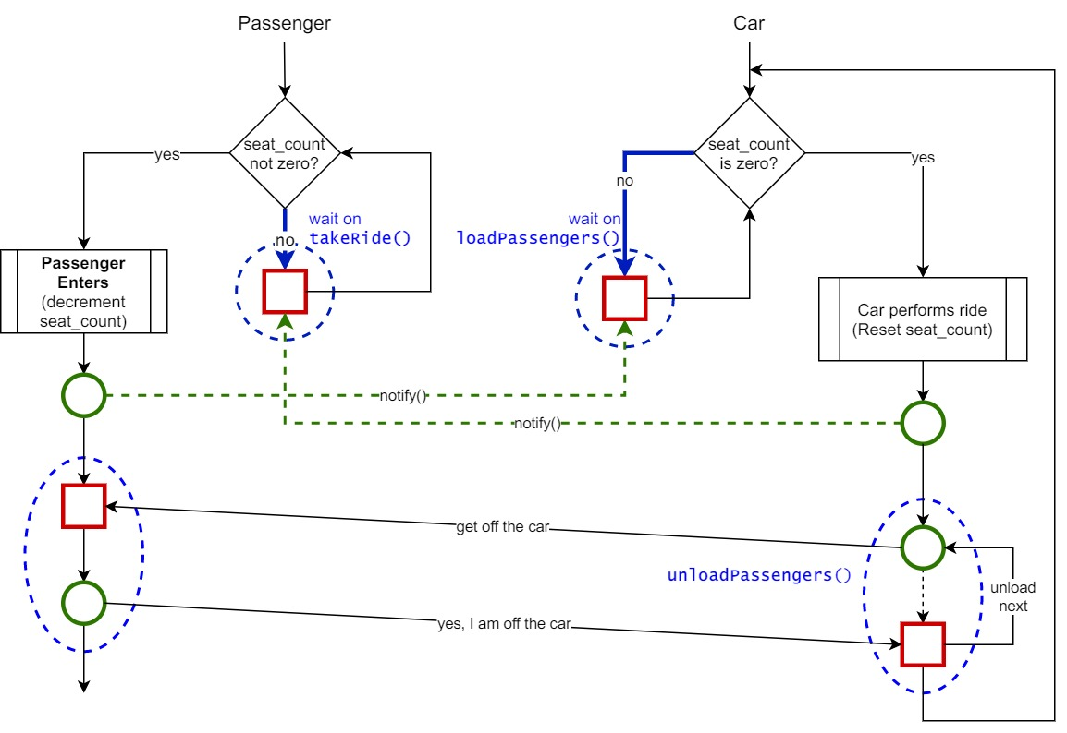

Slide 12
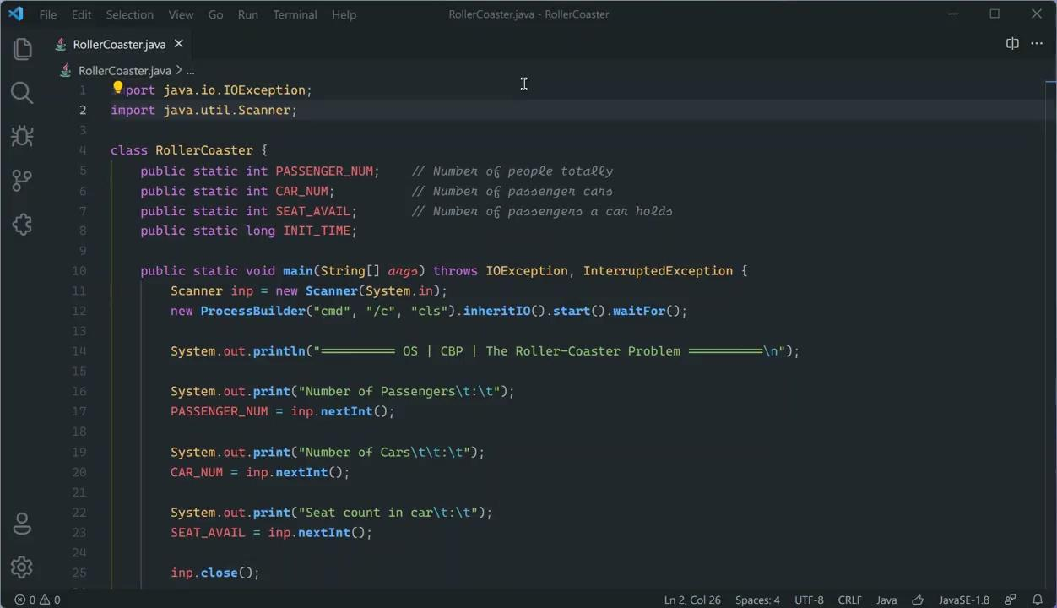
Output

Slide 13


